Slide 1
Natural Language Processing
Stock Prediction:
RNN +
Tweets Sentiment Analysis
Yuen Tak Cheung 57160006
Keung Yat Long 57146792

Slide 2
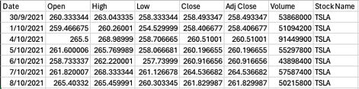
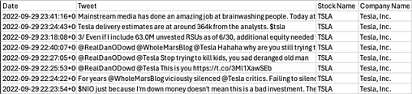

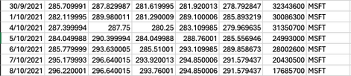
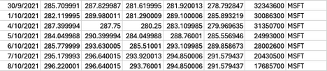
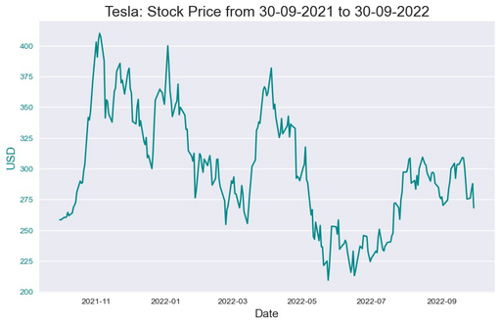
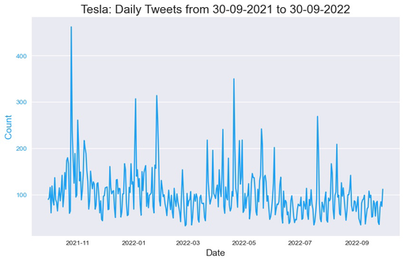
Problem Formulation
Datasets
Financial dataset
Tweets dataset
Comment of social media may affect stock price of a company
Analysing textual content from social media may brought us insight
Prediction may be done by the relationship between comment and stock price
Case study: Tesla as the subject of analysis
Provide historical stock market data
Tweets related to stock market discussion

Slide 3

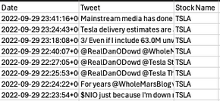
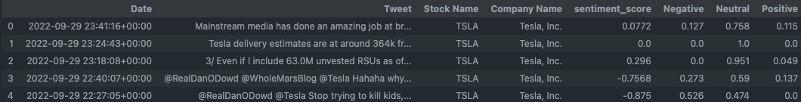
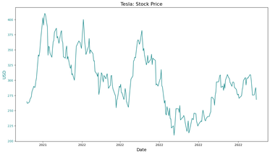
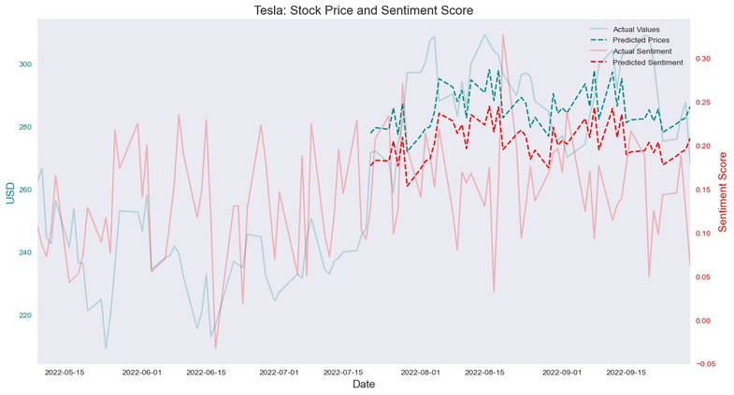
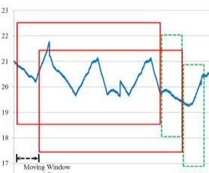
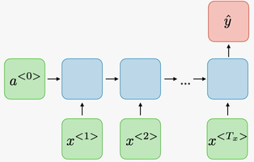
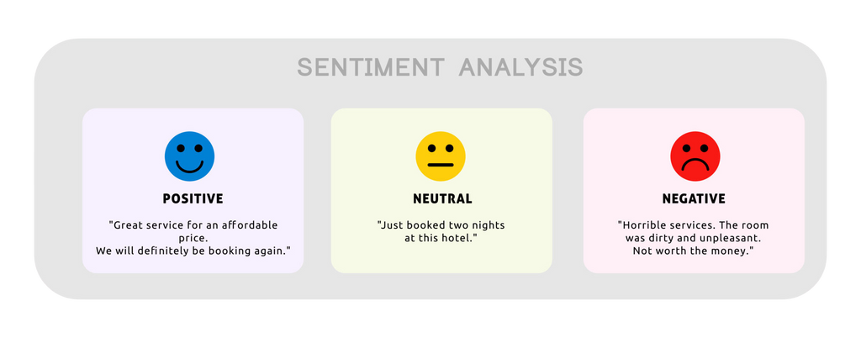

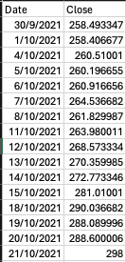
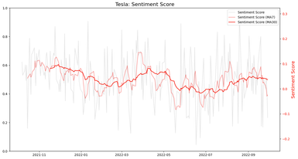
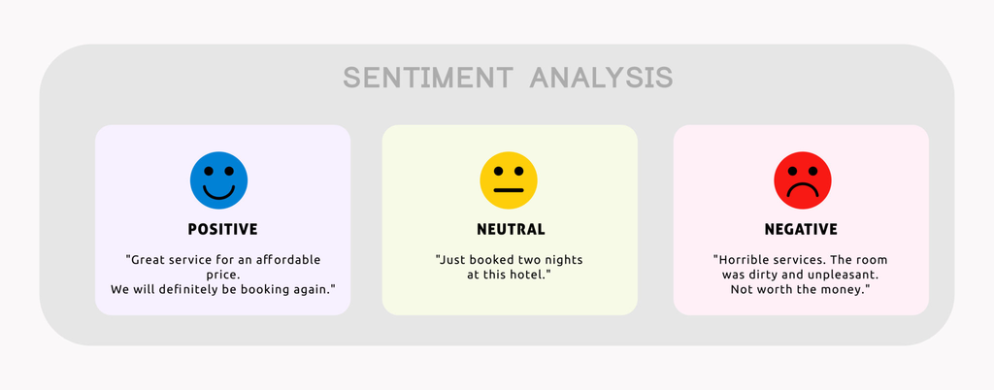

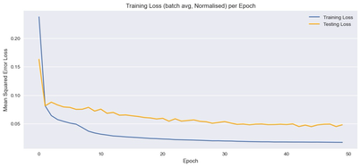
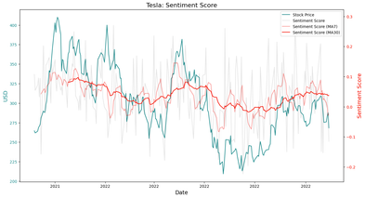
Method of Approach
01
02
03
04
05
06
Importing
Data
Sentiment Analysis
Data Aggregations
Data Preprocessing
RNN
Model
Prediction

Slide 4
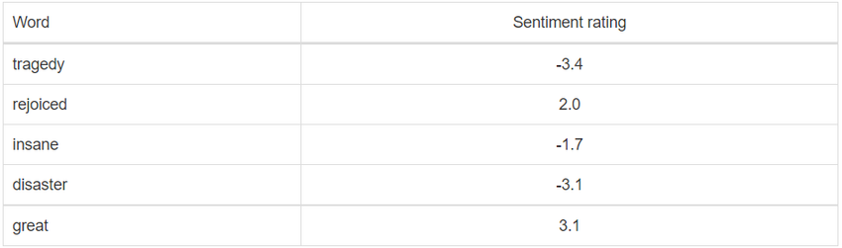
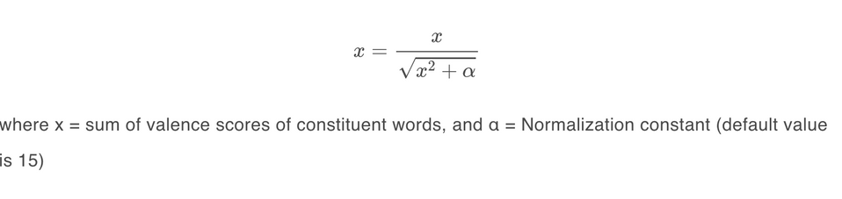
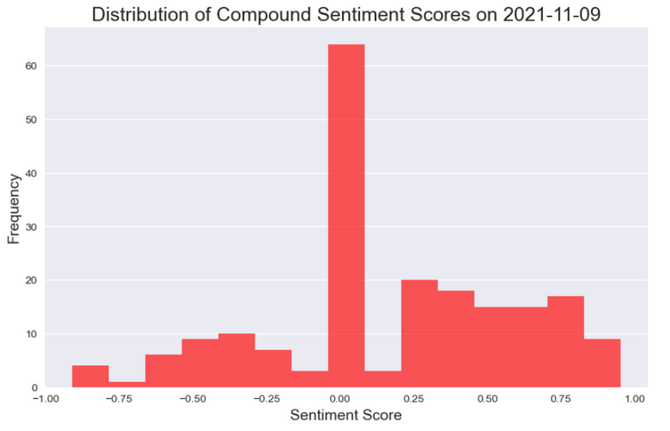
NLP Model for Sentiment Analysis
VADER: lexicon-based NLP model
Strong words have very positive or negative sentiment rating
Polarity score: sum of the ratings, normalised to range (-1,1)
Why choose rule-based model over embedding-based model for Tweets?
Polarity score more informative for inputs than positive/negative
Recognise evolving language: emojis (ಠ_ಠ) and slang (Sus)
Very fast with high accuracy
(S.D. = 0.43-0.46 per day)

Slide 5
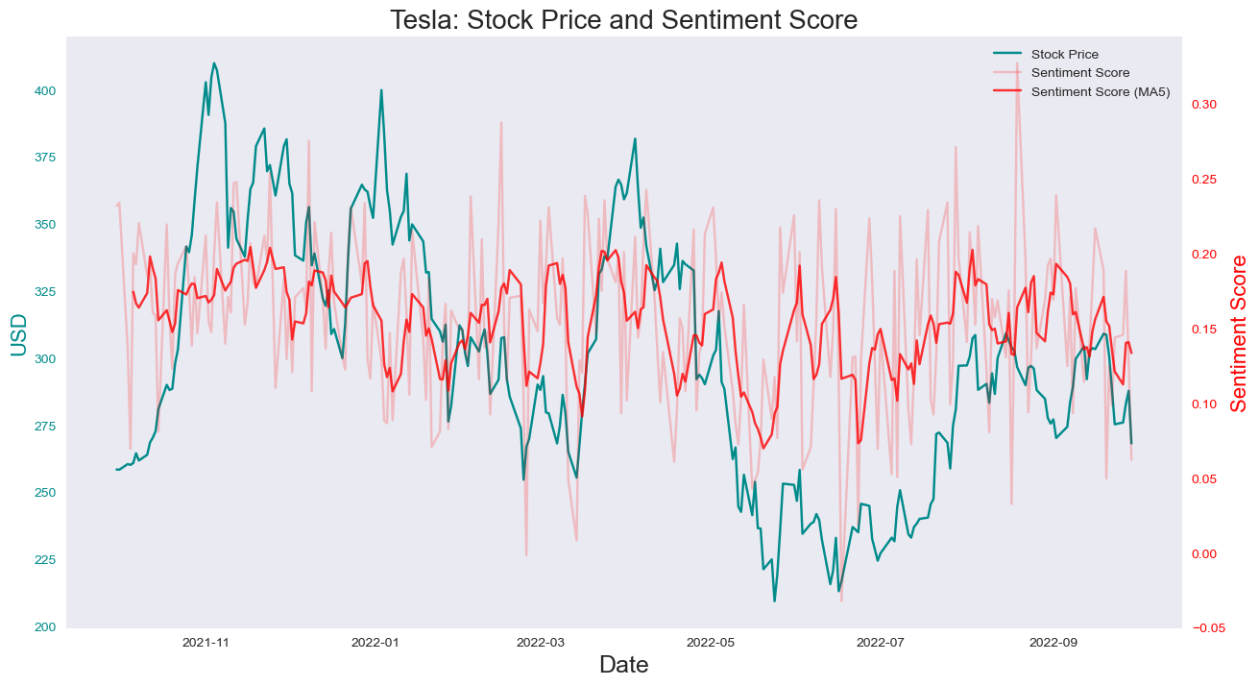
Data Aggregations
Further text cleaning
Some special cases which are not recognised by VADER need manual removal:
URLs: “http://great.china.mobile.com”
Mentions (usernames): @terrible_peter
Relating sentiments on stock prices
Group sentiment scores by dates and then take averages
Ignore weekends’ tweets when the market is closed
At least one month of dependency (20 days) is needed

Slide 6
Data Preprocessing
Prepare inputs and outputs
Entity | Shape | Type | Remark
dataset2 | 252x2 | DataFrame | Close & sentiment_score
dataset_train, scaled_train | (202, 2) | Array | 50 days for testing
dataset_test, scaled_test | (50, 2) | Array | 50 days for testing
X_train, y_train | (162, 40, 2) | Array | X: ith day to (i+39)th day y: (i+1)th day to (i+40)th day
X_test, y_test | (30, 20*, 2) | Array | X: ith day to (i+39)th day y: (i+1)th day to (i+40)th day
batch_X, batch_y | (16, 40, 2) | Tensor | Batch size = 16
batch_X_test, batch_y_test | (16, 20, 2) | Tensor | Batch size = 16
Split into training & testing sets
MinMaxScaler (0 to 1) for equal feature contribution
Sequential inputs & labels using window slicing
PyTorch Wrapper
Convert into Tensor
Batching using Dataloader for more efficient convergence
*Time sequence length for testing is not necessarily equal to training

Slide 7
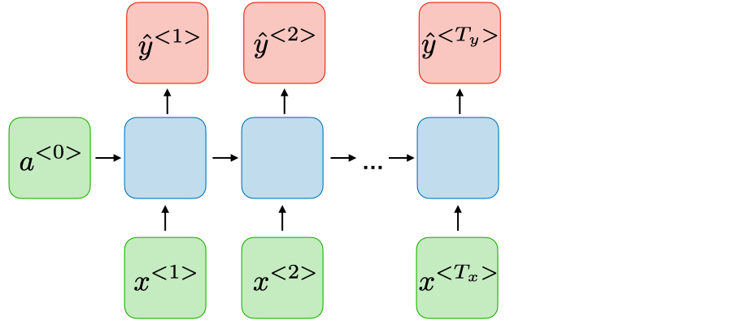
Recurrent Neural Network
Many-to-many architecture
Customisable input and output lengths to predict future stock prices and sentiment scores
Shared weights to generalise across different time steps and recursive hidden states to maintain memory of past inputs for context
Adjustments
Long short-term memory (LSTM) network for longer dependencies and prevents gradient vanishing
Adam Optimiser for adaptive learning rate (larger steps in simpler regions and smaller in more complex ones)
Randomly dropping hidden states to avoid overfitting to specific patterns

Slide 8
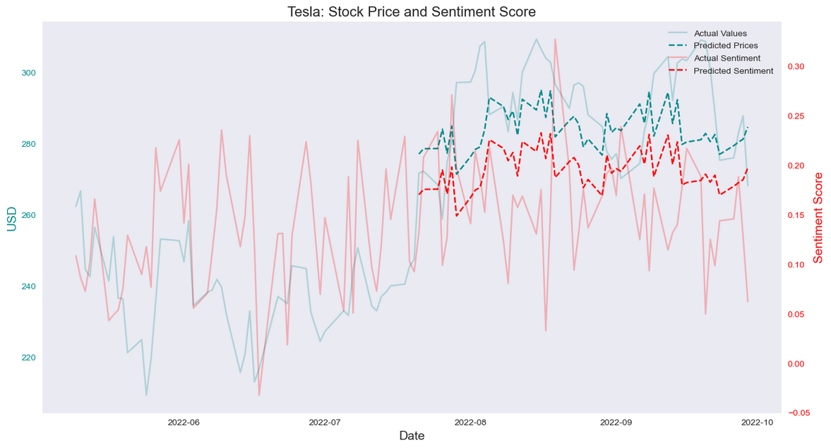
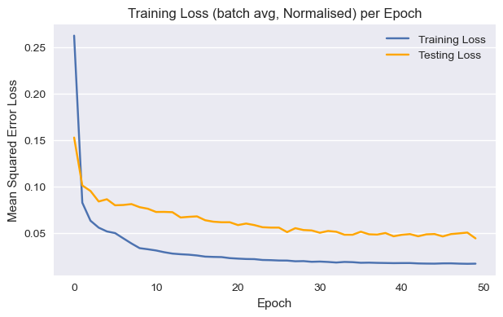
Results
Conclusion: Oversimplified Model and Insufficient Features
Training
Prediction
Training temporarily stopped during evaluation
Both losses converged
High testing loss
Rolling Prediction based on past predictions
Stock prediction follows actual trends with a high bias
Sentiment prediction has a very similar pattern

Slide 9
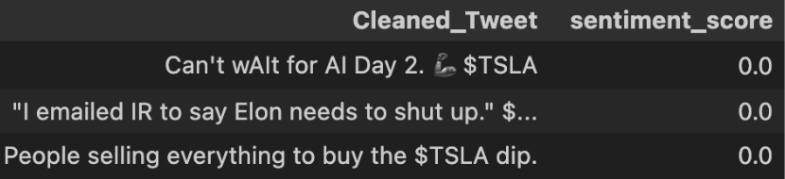
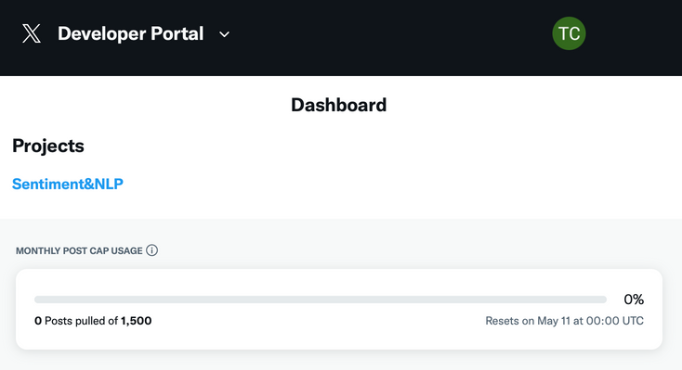
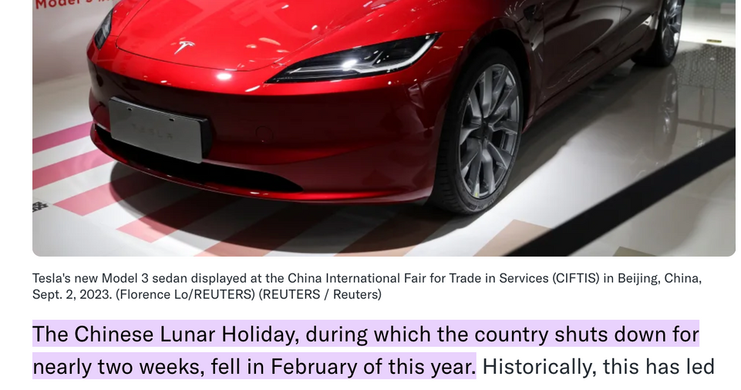
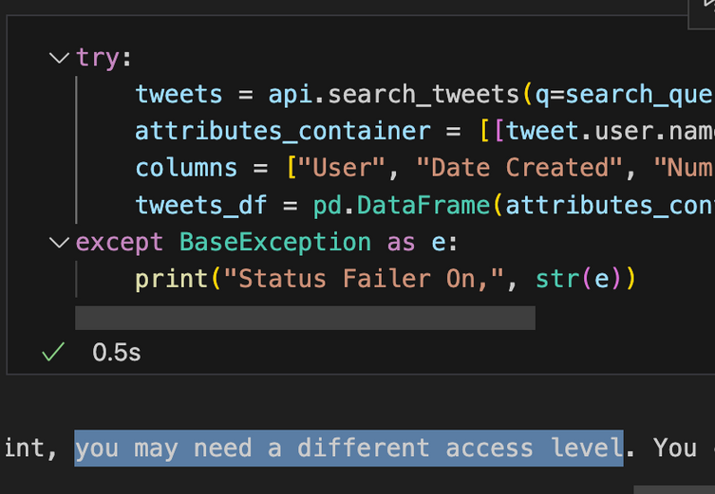
Discussion
Challenging Issues
Future Improvements
Uncommon emojis and ironic sentences not recognised:
Statistics indicators (Moving Average Convergence Divergence) & economic indicators (interest rates)
Separate training for sentiments (with careful tuning)
Multi-task learning with separate layers
Extract more data directly from X API (subscription):
Outer uncertainties: COVID shutdown, Elon Musk, War:

